Slide 3
The Taxonomic Analysis workshop
Mikael Lenz Strube
milst@dtu.dk

Slide 4
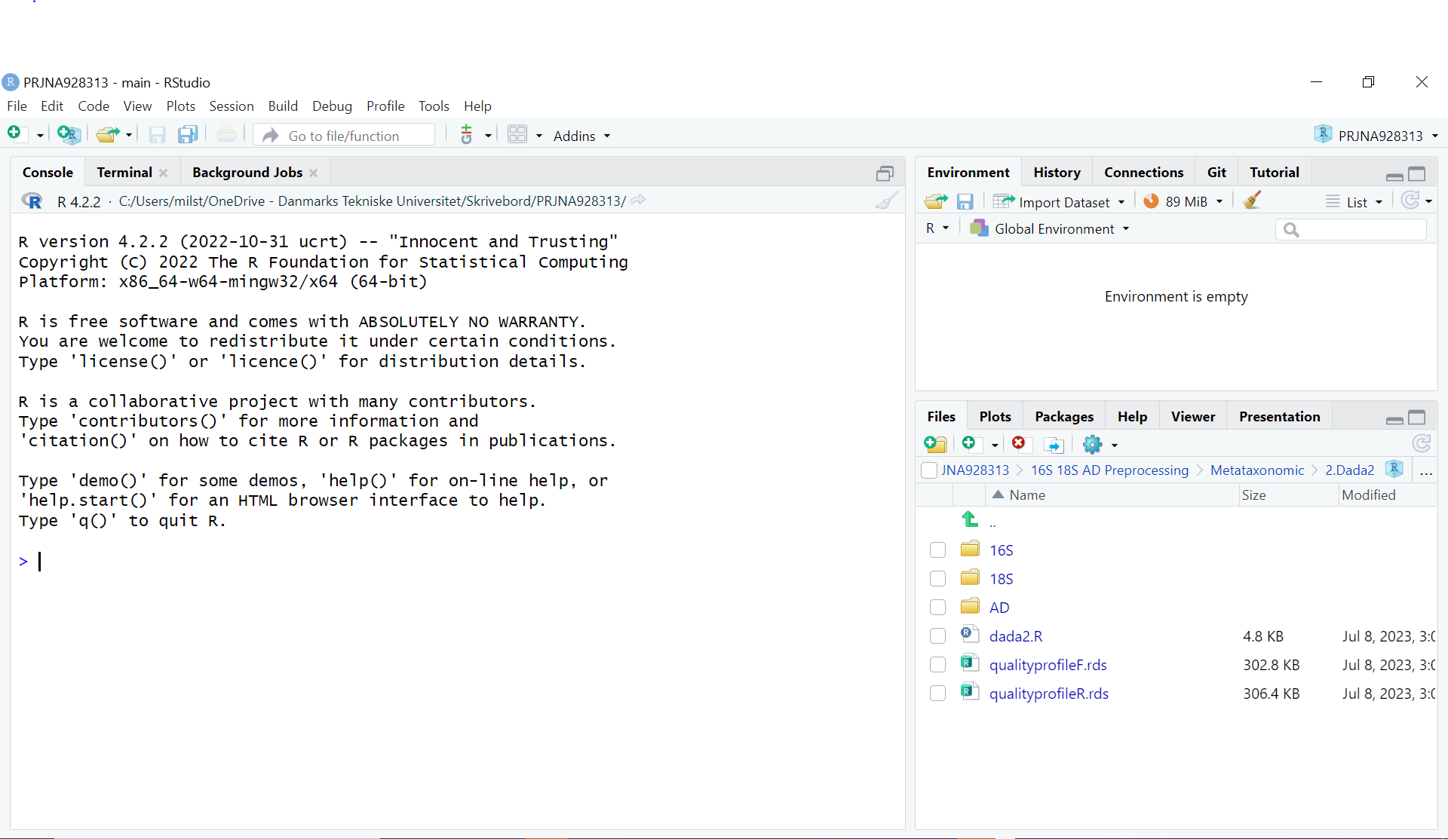
Ctrl+shift+n

Slide 5
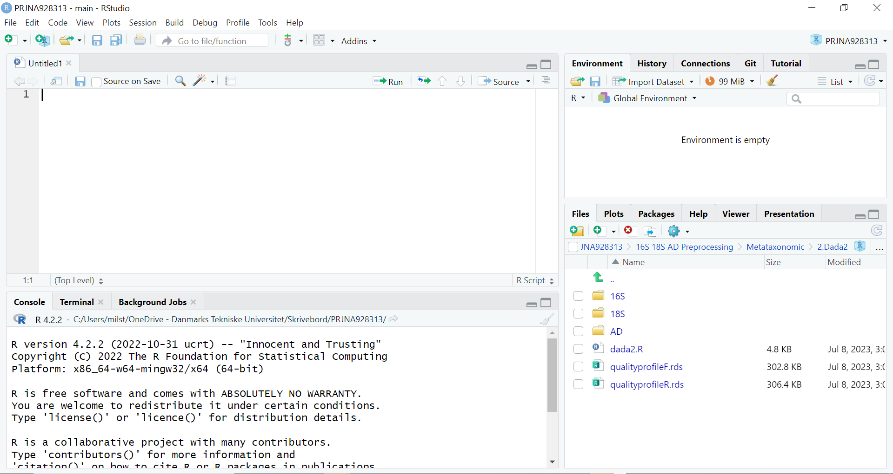
ENVIRONMENT
(MEMORY)
EDITOR
FILES
PLOTS
PACKAGES
CONSOLE

Slide 6
ENVIRONMENT
(MEMORY)
EDITOR
FILES
PLOTS
PACKAGES
CONSOLE

Slide 7
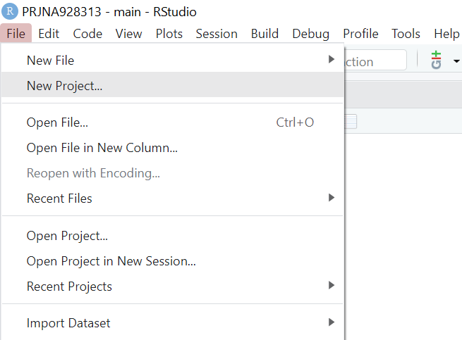
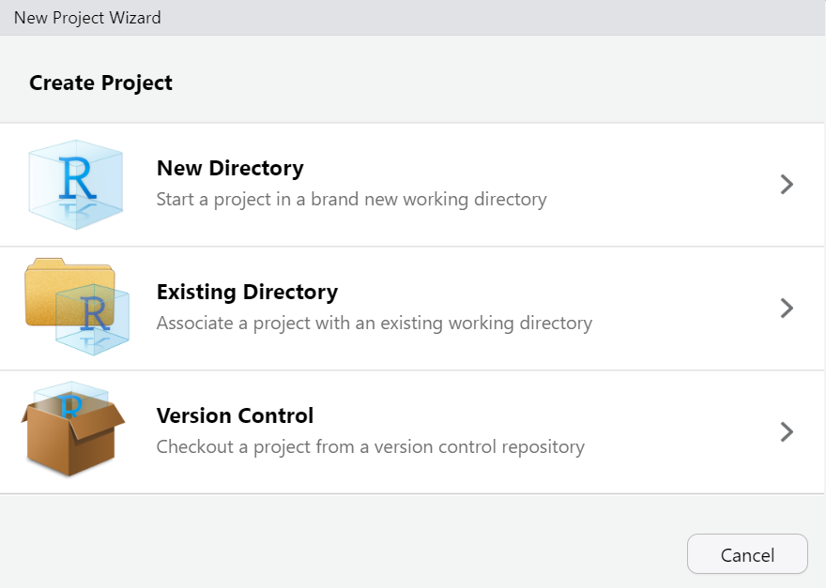
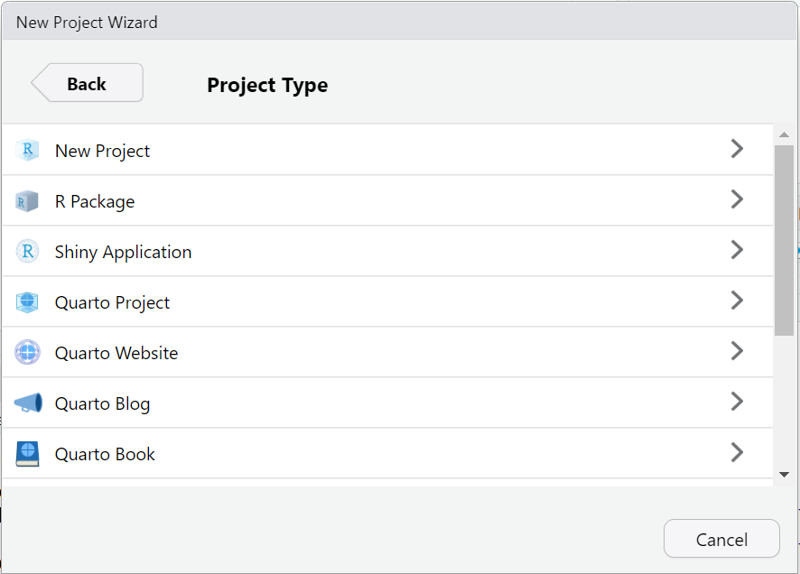
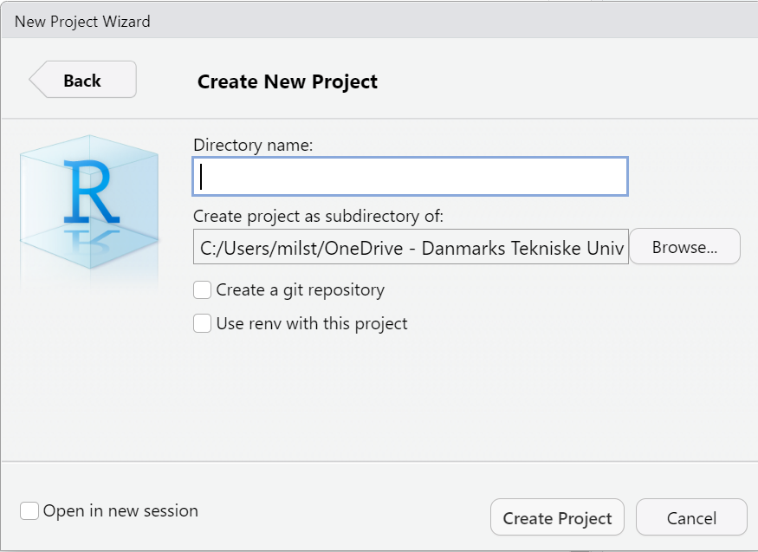

Slide 8
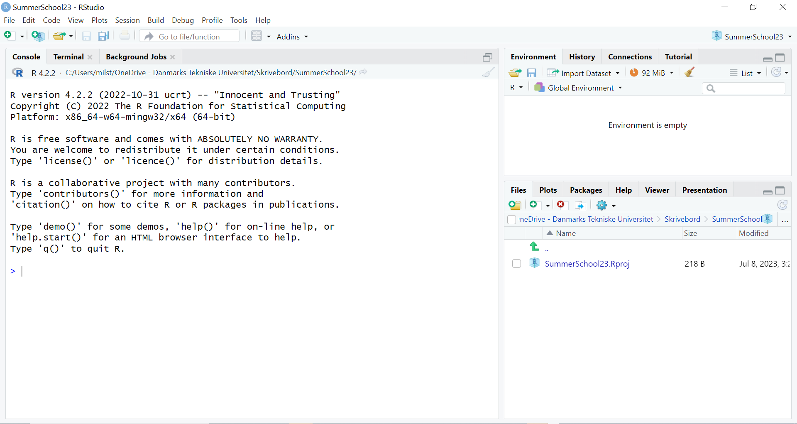

Slide 9
